Slide 1
Photomicrographs of Plant foods
Banana
Permission to reproduce original photomicrographs used to make this collection may be obtained from
Dr. David O. Norris at
david.norris@colorado.edu

Slide 2
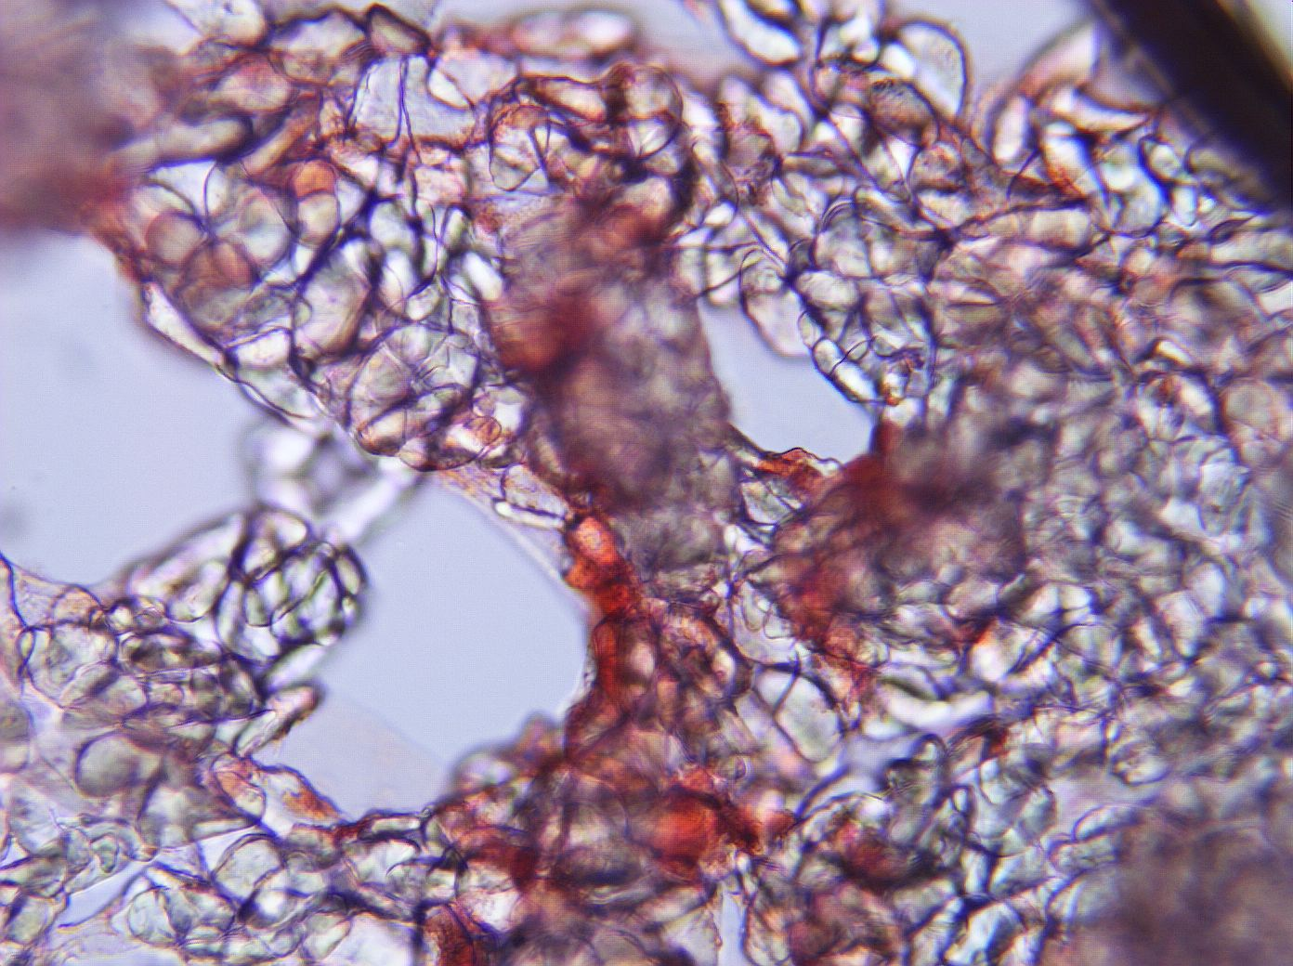
Notes:
33. Musa acuminata Colla Banana. Edible pulp cells, 25X.

Slide 3
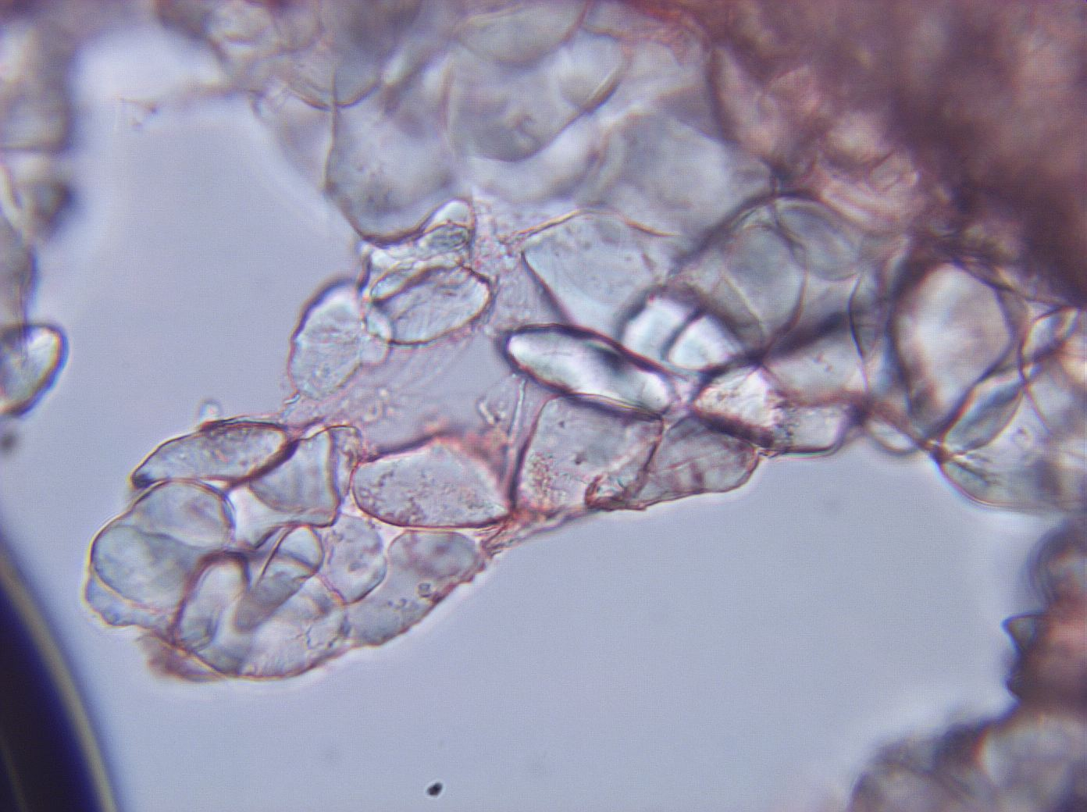
Notes:
34. Banana. Pulp cells, 40X.

Slide 4
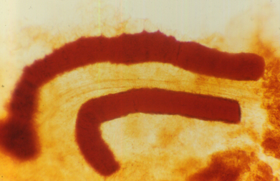
Notes:
35. Banana, fibers stained with safranin, 10X.

